Slide 1
PROGRAMMING FOR PROBLEM SOLVING
SEMESTER:1ST

Slide 2
CHAPTER 2 : Fundamentals of C TOPIC 1 : Features of c
Simple – structured approach
Machine Independent or Portable - can be executed on different machines with some machine specific changes
Mid-level programming language - intended to do low-level programming but also supports the features of a high-level language.
Procedural language - uses the set of instruction to inform/guide computer what to do step by step.

Slide 3
FEATURES OF C CONTD….
Rich Library - provides a lot of inbuilt functions
Memory Management – provides dynamic memory allocation.
Fast and Efficient - compilation and execution time of C language is fast
Statically Type - the type of variable is checked at the time of compilation but not at run time
Extensible - it can easily adopt new features

Slide 4
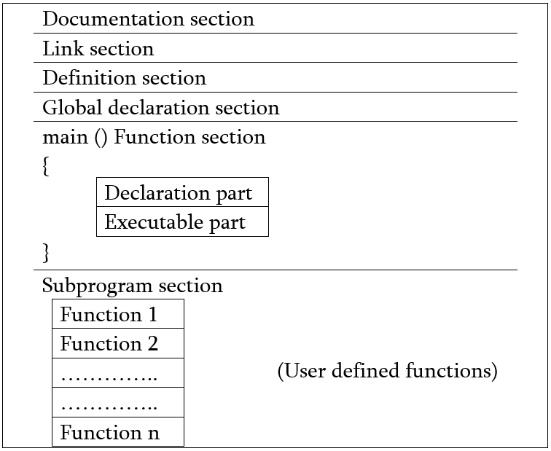
TOPIC 2: Structure of c program

Slide 5
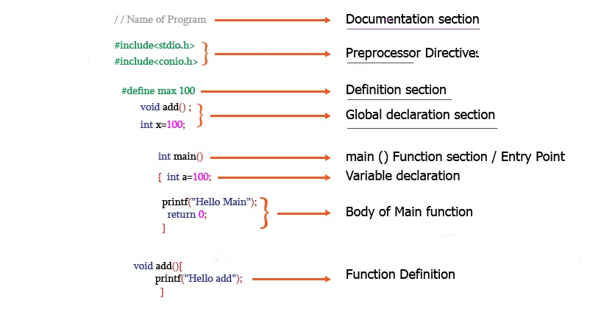
Example of Structure of c program

Slide 6
Basic Structure of C Program
Documentation Section:
consists of comment lines
helps anyone to get an overview of the program.
Link Section
consists of the header files of the functions that are used in the program.
It provides instructions to the compiler to link functions from the system library.

Slide 7
Basic Structure of C Program contd..
Definition Section
All the symbolic constants are written in definition section.
Macros are known as symbolic constants.
Global Declaration Section
used anywhere in the program are declared in global declaration section.
declares the user defined functions.

Slide 8
Basic Structure of C Program contd..
main() Function Section
one main() function section in every C program.
contains two parts, declaration and executable part.
Subprogram Section
contains all the user defined functions that are used to perform a specific task.
user defined functions are called in the main() function.

